Slide 1
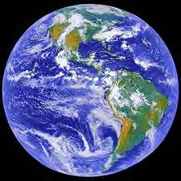
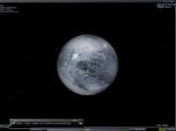
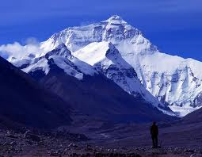
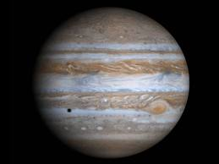
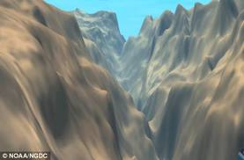
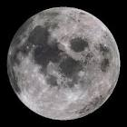
Journey
grams/
kilograms
Mass
Scale
Weight
Through Mass and Weight
Pounds/
Newtons
Triple Beam Balance

Slide 2
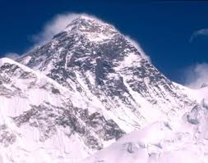
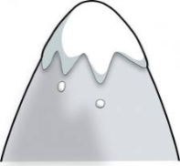
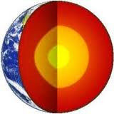
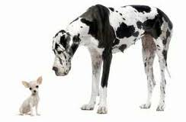
Mt. Everest
Where is your source of gravity?
The
Center
Of Earth
NO!
Your mass hasn’t changed!
Mt Everest
weaker
Farther
Medfield
DECREASES
NOTHING!
Stays the Same!
Has my inertia changed? WHY?
What happens to my weight? WHY?
Are you closer or farther from the center of gravity than in Medfield?
What happens to my mass? WHY?
Is the pull of gravity STRONGER or weaker than in Medfield?

Slide 3
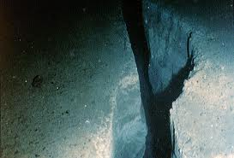
Mariana Trench
Where is your source of gravity?
STRONGER
NO!
Your mass hasn’t changed!
INCREASES
The
Center
Of Earth
Mariana Trench
Closer
Medfield
NOTHING!
Stays the Same!
What happens to my weight? WHY?
Are you closer or farther from the center of gravity than in Medfield?
What happens to my mass? WHY?
Has my inertia changed? WHY?
Is the pull of gravity STRONGER or weaker than in Medfield?

Slide 4
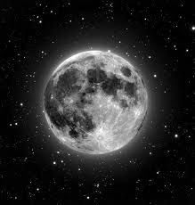
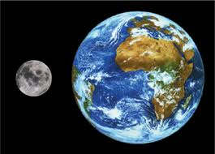
Moon
Where is your source of gravity?
DECREASES
The
Center
Of the Moon
What has more mass – Earth or the Moon?
More Mass = More Gravitational Pull
NOTHING!
Stays the Same!
Earth!
Which place has a STRONGER gravitational pull? WHY?
Earth!
What is the relationship between MASS and Gravitational Pull?
What happens to my mass? WHY?
What happens to my weight? WHY?

Slide 5
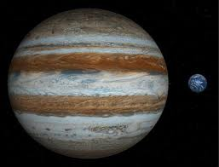
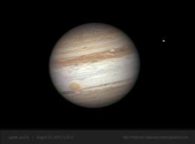
Jupiter
Where is your source of gravity?
The
Center
Of
Jupiter
INCREASES
More Mass = More Gravitational Pull
What has more mass – Earth or Jupiter?
NOTHING!
Stays the Same!
Jupiter!
Jupiter!
Which place has a STRONGER gravitational pull? WHY?
What is the relationship between MASS and Gravitational Pull?
What happens to my mass? WHY?
What happens to my weight? WHY?

Slide 6
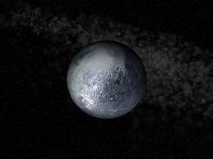
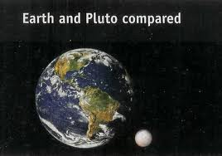
Pluto
Where is your source of gravity?
DECREASES
The
Center
Of
Pluto
More Mass = More Gravitational Pull
What has more mass – Earth or Pluto?
NOTHING!
Stays the Same!
Earth!
Which place has a STRONGER gravitational pull? WHY?
Earth!
What is the relationship between MASS and Gravitational Pull?
What happens to my mass? WHY?
What happens to my weight? WHY?

