Slide 1
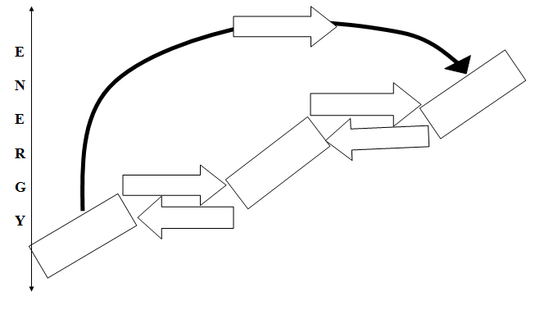
Sublimation
Gas
Vaporizing
Condensing
Liquid
Melting
Freezing
Solid

Slide 2
Solid to Liquid
Melting!!!

Slide 3
Solid to Gas
Sublimation!!!

Slide 4
Liquid to Solid
Freezing!!!

Slide 5
Liquid to Gas
Vaporizing!!!

Slide 6
Gas to Liquid
Condensing!!!

Slide 7
Solid to Liquid
Melting!!!

Slide 8
Gas to Liquid
Condensing!!!

Slide 9
Solid to Gas
Sublimation!!!

Slide 10
Liquid to Gas
Vaporizing!!!

Slide 11
Liquid to Solid
Freezing!!!

